Slide 1

Sprint #6 Presentation
Notes:
Alex

Slide 2


Sprint #6 Goals
Work and research more on recommendation
Work on front end necessities
Continue with database
Notes:
Dane

Slide 3
Updates
Business Requirement Document
No updates
Product Requirement Document
Updated Sprint Board, Gantt Chart, Burndown Chart, Project Tracker
User Stories
Released user stories this sprint
None
Notes:
Dane

Slide 4
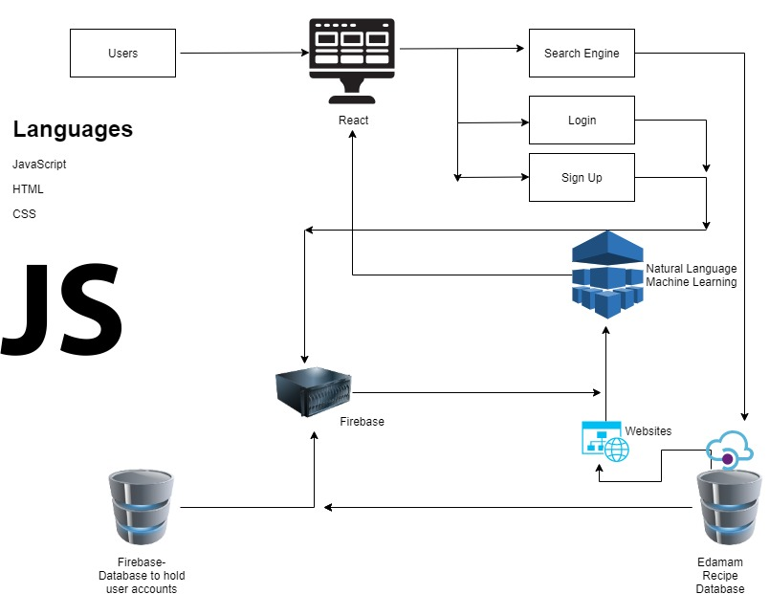


Architecture
React.js used for front-end
1 API - Edamam API (3rd Party)
User Platforms:
Chrome Extension
Web application
ODM Library: Firebase Firestore
ODM
Our own database
Notes:
Jose

Slide 5
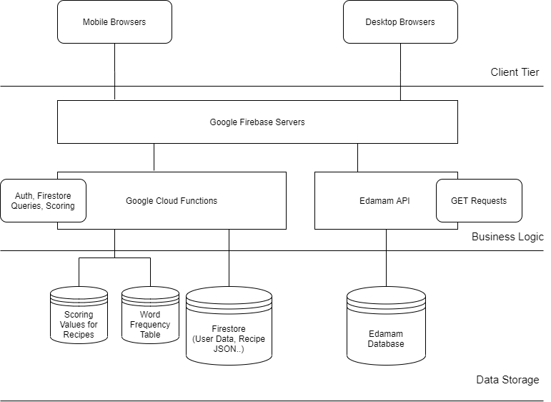
Client-Side Architecture
Notes:
john

Slide 6
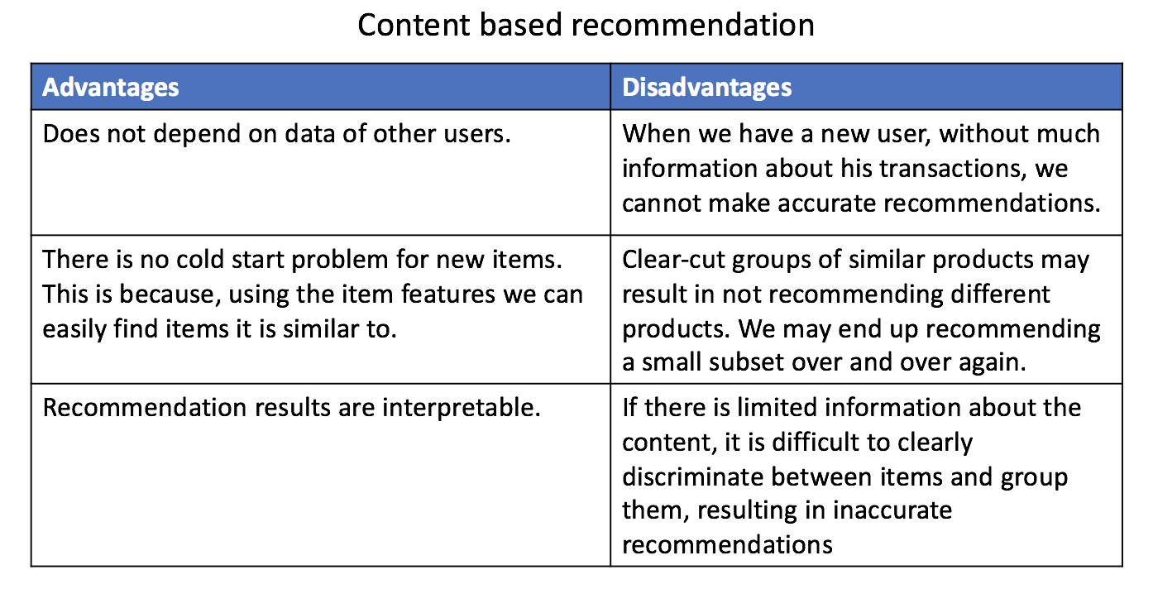
Recommendation Model - Content Based
Notes:
jose

Slide 7
Content Based
Goal: To create a ‘profile’ for each user and each item
Example: Given a 100 recipes with a vocabulary of size N.
First: compute the tf-idf score for each of the words for every article
Tf-idf: term frequency-inverse document frequency Tf: how often a term occurs in a document. TF = numTimesTerm / totalNumTerms Idf: measures how important a term is. IDF = log_e(totalNumDocuments / numTermInDocuments)
Second: construct 2 vectors: an Item vector and a user vector
Third: compute similarities between the two vectors
Items that are recommended are the ones that the user has the highest similarity with or has the highest similarity with the other items the user has.
Notes:
Item vector: contains 1 for words that have a high tf-idf score in that article otherwise 0 User vector: 1xN vector: For every word, we store the probability of the word occurring (i.e. having a high tf-idf score) in articles that the user has consumed. Note here, that the user vector is based on the attributes of the item (tf-idf score of words in this case).

Slide 8
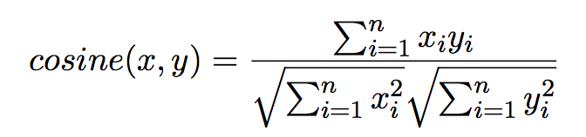
Content Based: Methods to find similarity
Cosine Similarity:
To compute similarity between the user and item, we simply take the cosine similarity between the user vector and the item vector. This gives us user-item similarity. To recommend items that are most similar to the items the user has bought, we compute cosine similarity between the articles the user has read and other articles. The ones that are most similar are recommended. Thus this is item-item similarity.

Slide 9
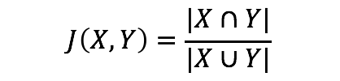
Content Based: Methods to find similarity
Jaccard Similarity:
AKA known as intersection over union
This is used for item-item similarity. We compare item vectors with each other and return the items that are most similar.

Slide 10
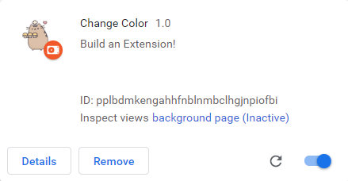
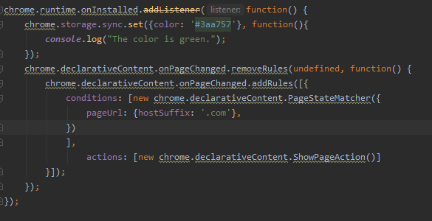
Chrome Extension

Slide 11
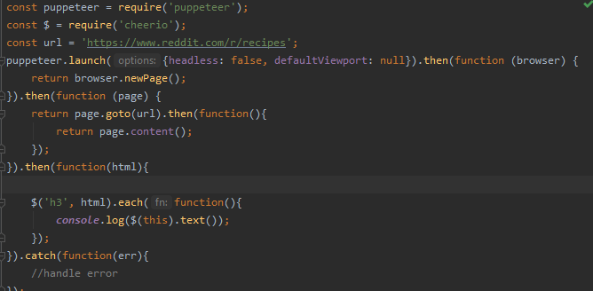
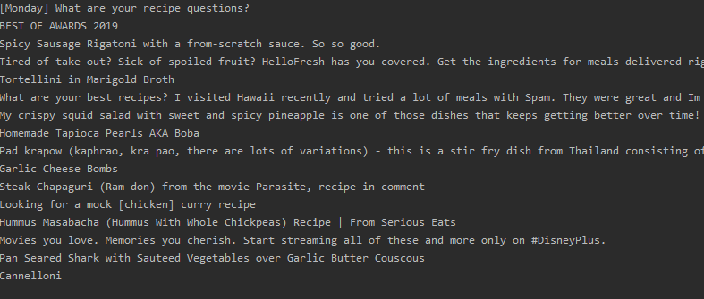

Slide 12
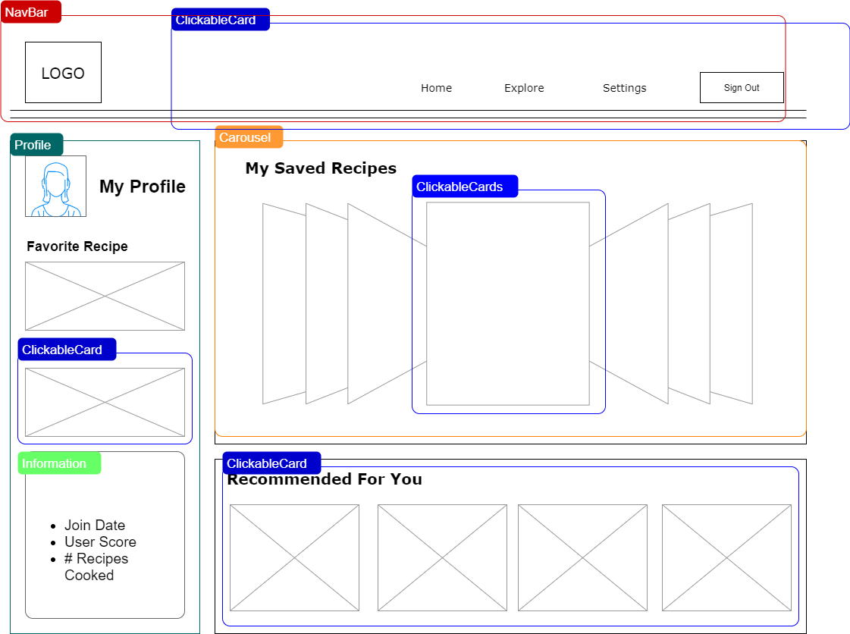
Front End Design: Home Dashboard
Notes:
john

Slide 13
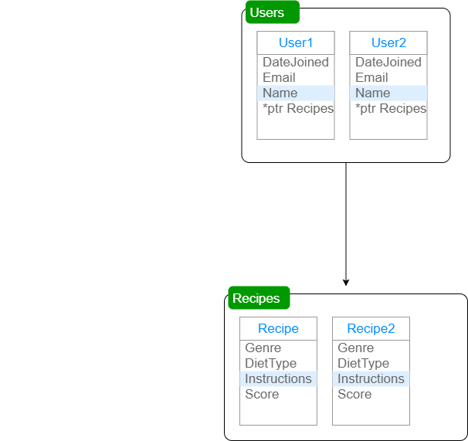
Storage Architecture
Notes:
john

Slide 14

Recipe Finder
High tier
refrigerate 34
ingredients 84
boil 123
Medium tier
tea 89
tablespoons 47
kosher 3
Low tier
temperature 37
dinner 3
paste 20
What even is this?
cannedif 1
135140f 1
Notes:
alex

Slide 15
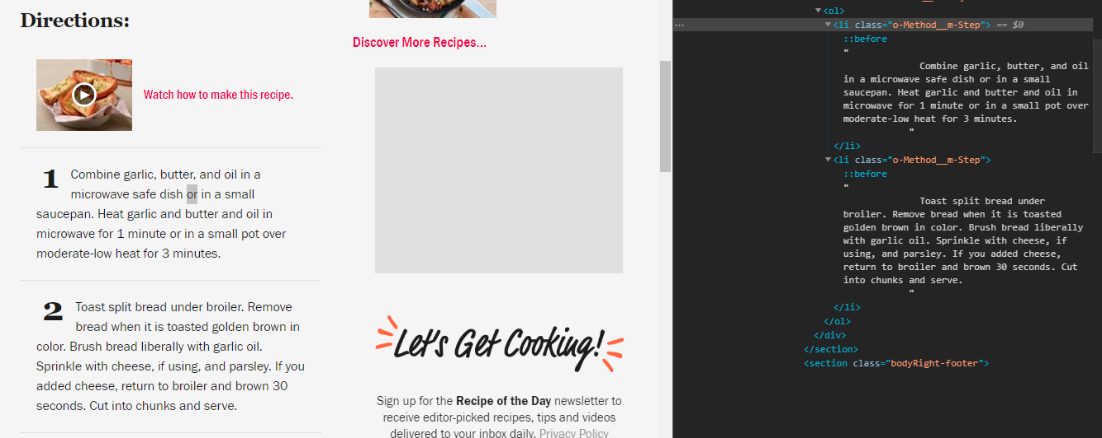

Slide 16
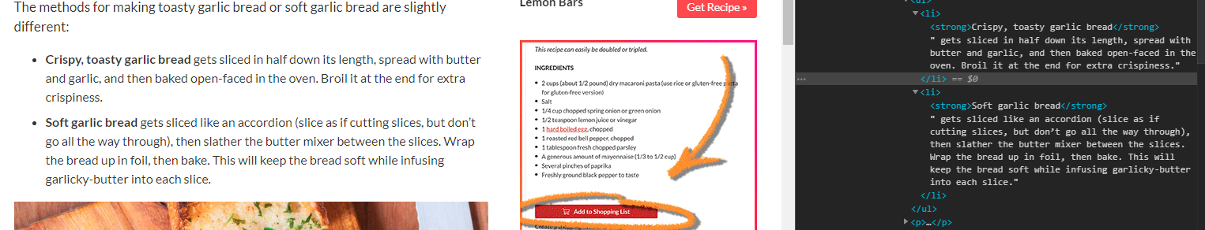
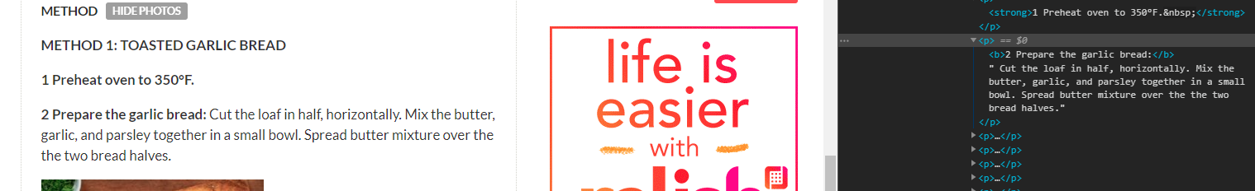
Notes:
same website

Slide 17
Web Parsing
What are our solutions?
Allow only websites that we choose to be parsed
Notes:
alex

Slide 18
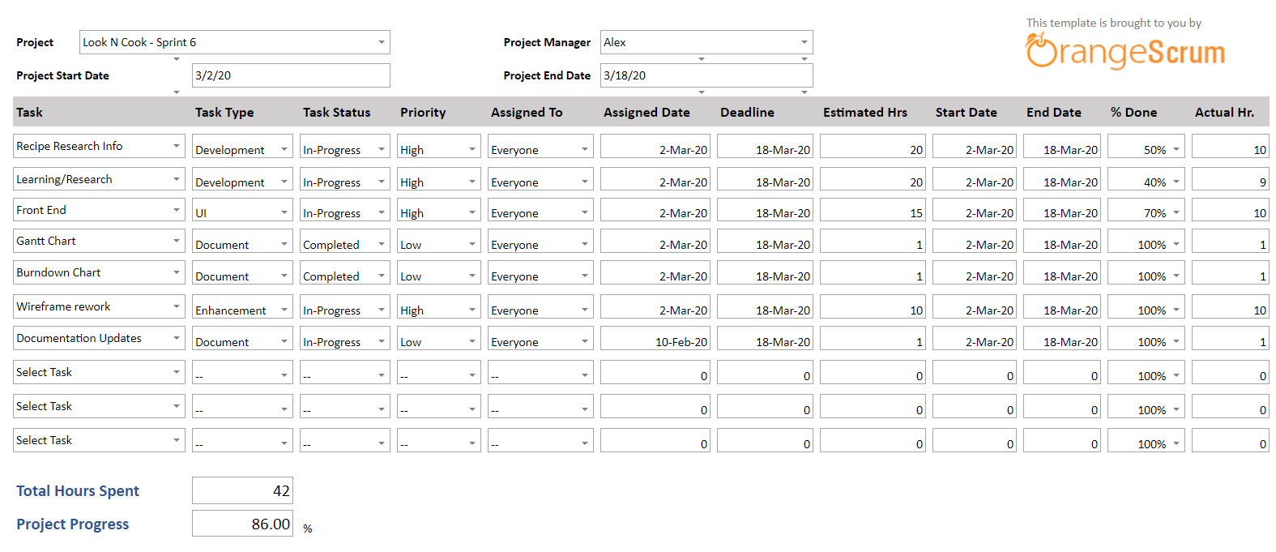
Project Tracker
Notes:
henry

Slide 19
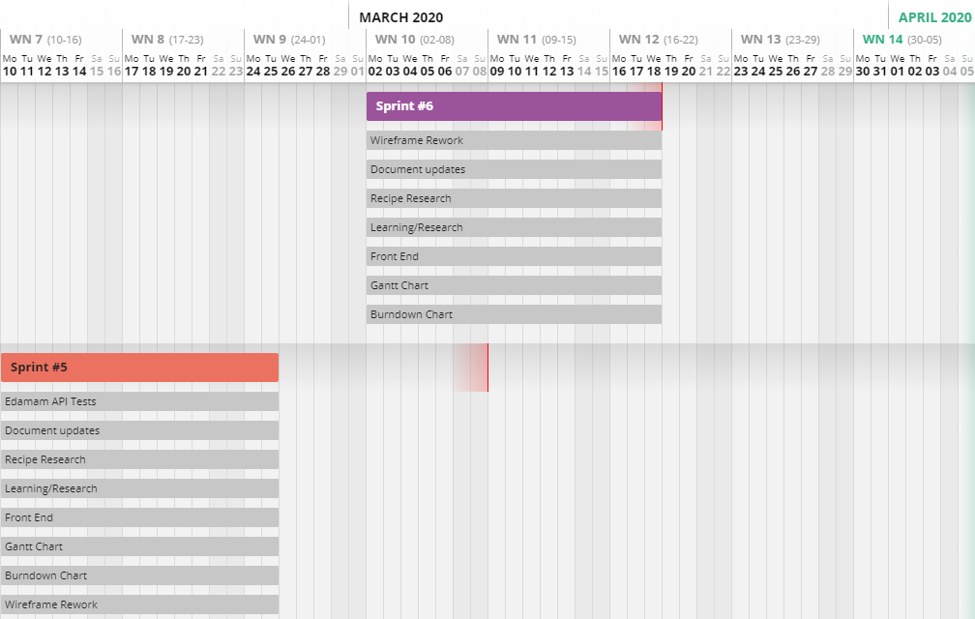
Gantt Chart
Notes:
henry

Slide 20
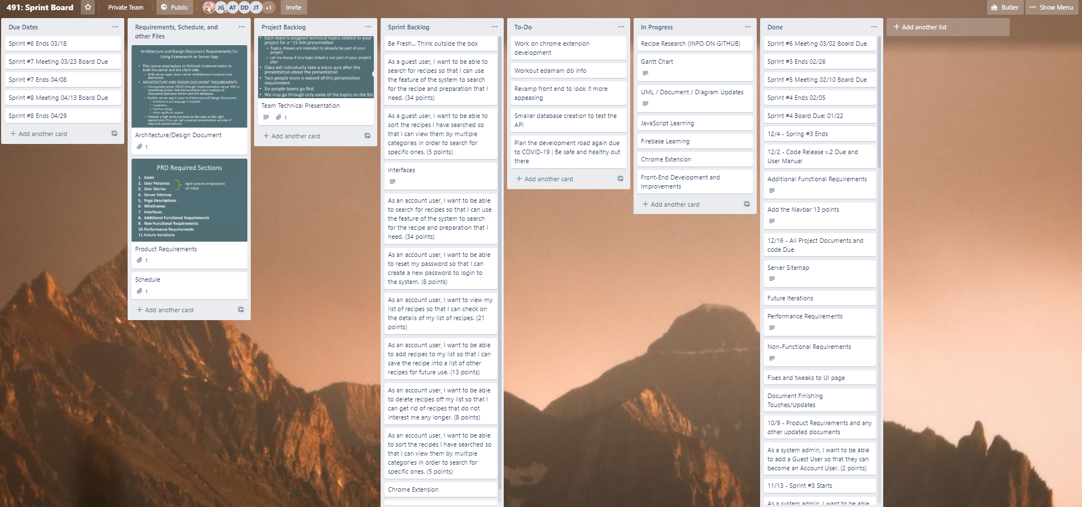
Sprint Board-Before
Notes:
henry

Slide 21
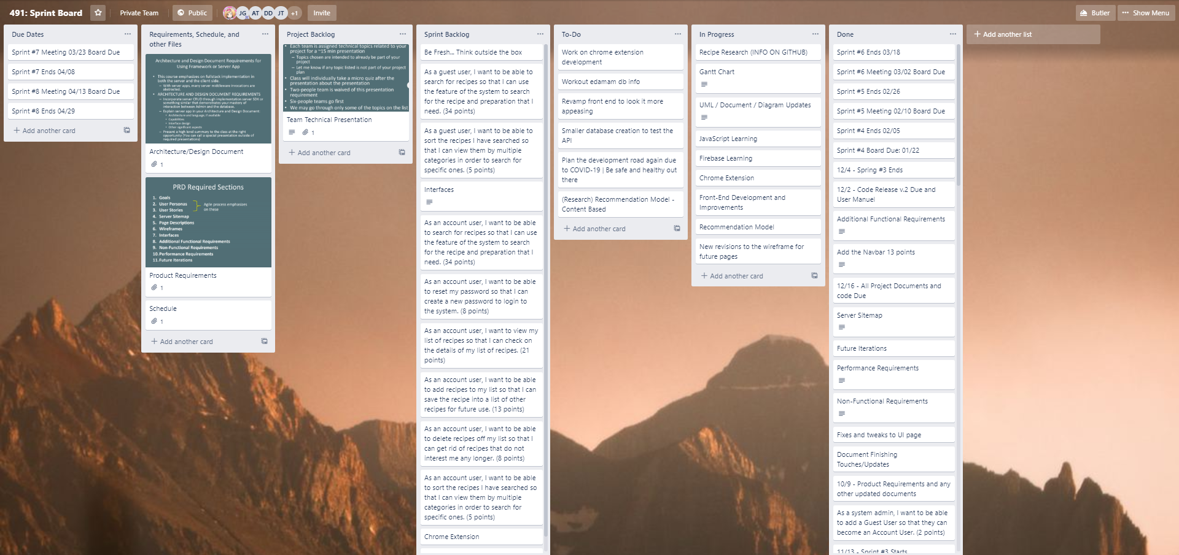
Sprint Board-After
Notes:
henry

Slide 22
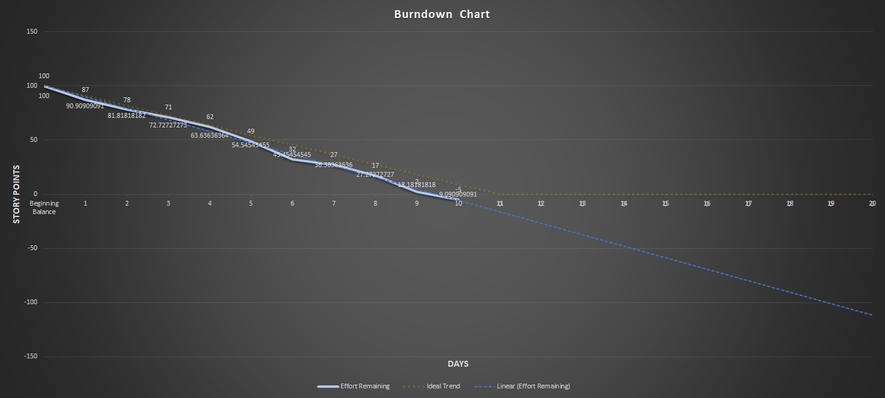
Burndown Curve
Notes:
Jose

Slide 23
Sprint Retrospective
What caused problems?
COVID-19 caused a lot of our schedule to change, as well as stress from the virus itself which took time away
How to improve for next sprint/Conclusions
Try to relax and go at a reasonable pace
to cope with lifestyle changes due to COVID-19
Did we meet our Sprint Goal?
Somewhat; we weren’t able to meet most of our expectations of this sprint due to time and other complications, but we made progress
What worked well/Didn’t work well?
Front-end making progress to align with our wireframe
The food database and research is progressing slowly but at a good pace
Schedule changes impacted work time
User story points planned: 42
User story points achieved: 36
User stories in progress: 5 (View list, add to list, remove from list, sort list, reset password)
Notes:
Dane

Slide 24

Plans for the next sprint
Continue working on the Chrome Extension
Continue working with our smaller database and website
Continue leftover tasks and getting back into the rhythm
Continue research tasks and necessities
Notes:
Dane

